Slide 1
Project Risk Management

Slide 2
Risk Management
“The process involved with identifying, analyzing, and responding to risk. It includes maximizing the results of positive risks and minimizing the consequences of negative events”

Slide 3
Why Do We Manage Risk?
Project problems can be reduced as much as 90% by using risk analysis
Positives:
  More info available during planning
  Improved probability of success/optimum project
Negatives:
  Belief that all risks are accounted for
  Project cut due to risk level

Slide 4
Key Terms
Risk Tolerance – The amount of acceptable risk
Risk Adverse – Someone that does not want to take risks
Risk Factors
  Probability of occurrence
  Impact of event
  Range of outcomes
  Timing of event

Slide 5
How Do We Manage Risk?
Use the six risk management processes
  Risk Management Planning
  Risk Identification
  Qualitative Risk Analysis
  Quantitative Risk Analysis
  Risk Response Planning
  Risk Monitoring and Control
Risk Management Planning
Risk Identification
Qualitative Risk Analysis
Quantitative Risk Analysis
Risk Response Planning
Risk Monitoring and Control

Slide 6
Risk Management Planning
Enterprise Environmental Factors
Inputs
Tools & Techniques
Planning Meetings and Analysis
Organizational Process Assets
Outputs
Risk Management Plan
Project Scope Statement
Project Management Plan
Risk Management Planning
Risk Identification
Qualitative Risk Analysis
Quantitative Risk Analysis
Risk Response Planning
Risk Monitoring and Control

Slide 7
What is a Risk Management Plan?
Methodology – Approach, tools, & data
Roles & Responsibilities
Budgeting – Resources to be put into risk management
Timing – When and how often
Risk Categories – Risk Breakdown Structure (RBS)
Definitions – Risk probabilities and impact

Slide 8
Risk Breakdown Structure
Lists categories and subcategories where risks may arise
Project
Technical
Organizational
Project Management
Limited Design Time
Funding
Estimates
Specifications Adherence
Prioritization
Scheduling
Resource Availability
Communication

Slide 9
Risk Register
List of
  Identified risks
  Potential responses
  Root causes
Updated risk categories (if required)

Slide 10

Methodologies
Probability and Impact Matrix
  Based on Failure Modes and Effects Analysis (FMEA)
  From 1950’s analysis of military systems

Slide 11
Probability and Impact Matrix
Define Probability Scale & Impact Scale
Impact Scale
Probability Scale
Consequence | Health and Safety
Extreme | Fatality or multiple fatalities expected
High | Severe injury or disability likely; or some potential for fatality
Moderate | Lost time or injury likely; or some potential for serious injuries; or small risk of fatality
Low | First aid required; or small risk of serious injury
Negligible | No concern
Likelihood Class | Likelihood of Occurrence (events/year)
Not Likely (NL) | <0.01% chance of occurrence
Low (L) | 0.01 - 0.1% chance of occurrence
Moderate (M) | 0.1 - 1% chance of occurrence
High (H) | 1 - 10% chance of occurrence
Expected (E) | >10% chance of occurrence

Slide 12
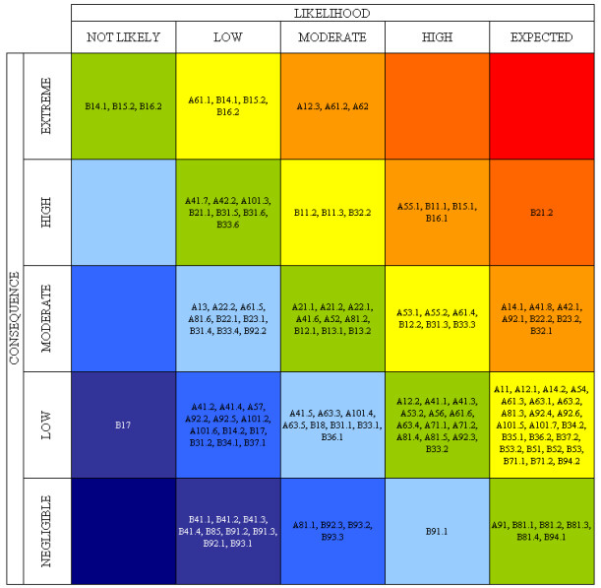
Probability and Impact Plots
Rate each risk on scales then plot on matrix
Develop mitigation technique for risks above tolerance

Slide 13
Risk Register Update
Add
  Probability and Impact Matrix results
  Perform quality check on results
  Categorize the risks to make them easier to handle
  Perform urgency assessment to determine which risk need immediate attention

Slide 14
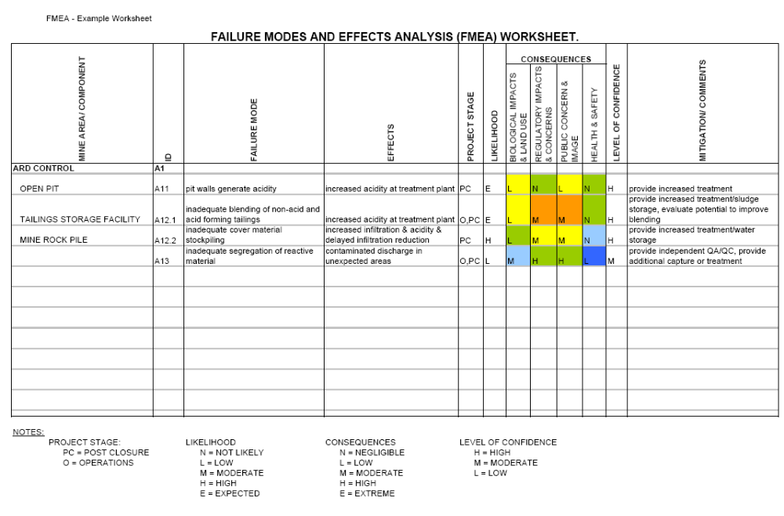
Risk Register

Slide 15
Quantitative Risk Analysis
Inputs
Tools & Techniques
Organizational Process Assets
Data gathering
Quantitative risk analysis and modeling
Project Scope Statement
Outputs
Risk Register (UPDATED)
Risk Management Plan
Risk Register
Project Management Plan (Schedule & Cost Plans)
Risk Management Planning
Risk Identification
Qualitative Risk Analysis
Quantitative Risk Analysis
Risk Response Planning
Risk Monitoring and Control

Slide 16
Quantitative Risk Analysis
Analyze numerically the probability and consequence of each risk
Monte Carlo analysis popular
Decision Tree analysis on test
  Diagram that describes a decision and probabilities associated with the choices
Expected Monetary Value Analysis (EMV)

Slide 17
Expected Monetary Value (EMV)
 | Building Cost | Probability
Optimistic Outcome | $150K | 0.2 | $30K
Likely Outcome | $225K | 0.5 | $113K
Pessimistic Outcome | $300K | 0.3 | $100K
Expected Value |  |  | $243K

Slide 18
Decision Tree Analysis
Decision Definition
Decision Node
Chance Node
Net Path Value
65%
$200
Strong Demand
$80
EMV of New Bldg Node = $41.5!
New Plant
-$120
35%
$90
Weak Demand
-$30
Build or Upgrade Plant
65%
$120
Upgrade Plant
-$50
Strong Demand
$70
EMV of Upgrade Node = $49!
35%
$60
Weak Demand
$10

Slide 19
Risk Response Planning
Inputs
Tools & Techniques
Strategies for negative risks or threats
Strategies for positive risks or opportunities
Strategy for both threat and opportunity
Contingent response strategy
Risk Management Plan
Outputs
Risk Register (UPDATED)
Risk Register
Project Management Plan (UPDATE)
Risk-related contractual agreements
Risk Management Planning
Risk Identification
Qualitative Risk Analysis
Quantitative Risk Analysis
Risk Response Planning
Risk Monitoring and Control

Slide 20
Strategies
Negative Risks (or Threats)
  Avoid
  Transfer
  Mitigate
  Acceptance
Positive Risks (or Opportunities)
  Exploit
  Share
  Enhance
  Acceptance

Slide 21
Risk Monitoring and Control
Tools & Techniques
Outputs
Inputs
Risk reassessment
Risk audits
Variance and trend analysis
Technical performance measurement
Reserve analysis
Status meetings
Risk Register (UPDATED)
Risk Management Plan
Requested Changes
Risk Register
Recommended Corrective Actions
Approved Change Requests
Recommended Preventive Actions
Work Performance Information
Org Process Assets (Update)
Performance Reports
Project Management Plan (Update)
Risk Management Planning
Risk Identification
Qualitative Risk Analysis
Quantitative Risk Analysis
Risk Response Planning
Risk Monitoring and Control

Slide 22
Risk Management Summary
Risk Management Planning – New
Risk ID – Develop categories & types
Risk Qualitative – Probability & Impact Analysis
Risk Quantitative – Decision Tree, EMV, Monte Carlo
Risk Response – Mitigation & contingency plans
Risk Monitoring and Control – Recurring evaluations
Risk Management Planning
Risk Identification
Qualitative Risk Analysis
Quantitative Risk Analysis
Risk Response Planning
Risk Monitoring and Control

